Slide 1
1D Motion

Slide 2
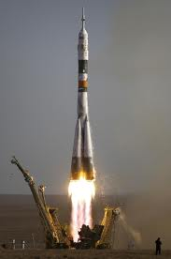
A rocket carrying a satellite is accelerating straight up from the Earth’s surface. At 1.15 s after liftoff, the rocket clears the top of tis launch platform, 63 m above the ground. After an additional 4.75 s, it is 1.00 km above the ground. Calculate the magnitude of the average velocity of the rocket for (a) the 4.75 s part of its flight and (b) the first 5.9 s of its flight.
a) For the additional 4.75 s part of it’s flight
a) For the first 5.9 s of it’s flight

Slide 3
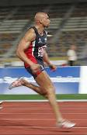
2.59 A world class sprinter accelerates to his maximum speed of 14.1 m/s in 4.0 s. He then maintains this speed for the remainder of a 100 m race, finishing with a total time of 9.1 s.
(a) What is the runners acceleration during the first 4 seconds?
(b) What is the runners acceleration during the last 5.1 seconds?
(c) What is average acceleration for the whole race?

Slide 4
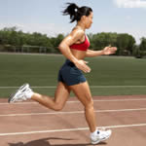
2.5 Runners around track
Two runner start simultaneously from the same point on a circular 200 m track and run in opposite directions. One runs at a constant speed of 6.2 m/s, and the other runs at a constant speed of 5.5 m/s. When they first meet, (a) for how long a time will they ben been running, and (b) how far will each one have run along the track?
(a) V=x/t So x=vt
(b) Substitute into v=x/t for each

